Slide 1
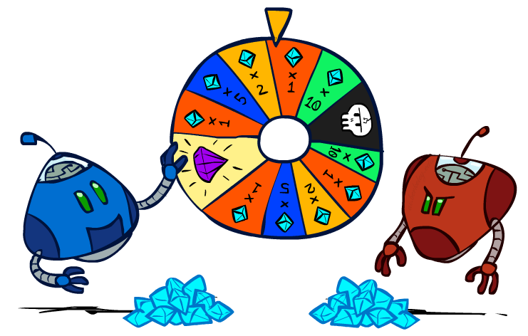
CSE 511A: Introduciton to Artificial Intelligence
Uncertainty and Utilities
Instructor: Roman Garnett
Washington University in St. Louis
[These slides were created by Dan Klein and Pieter Abbeel for CS188 Intro to AI at UC Berkeley. All CS188 materials are available at http://ai.berkeley.edu.]
Notes:
Please retain proper attribution, including the reference to ai.berkeley.edu. Thanks!

Slide 2
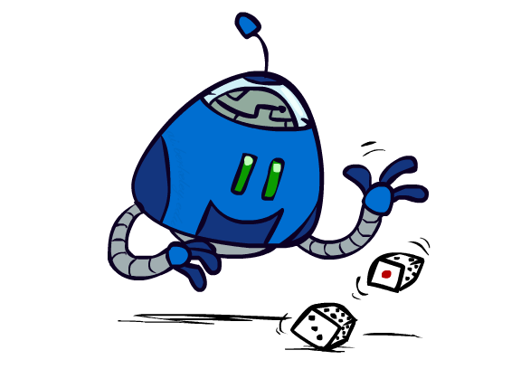
Uncertain Outcomes

Slide 3
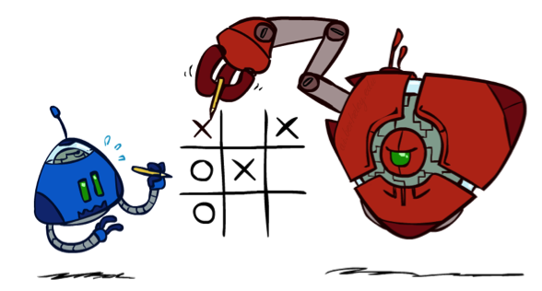

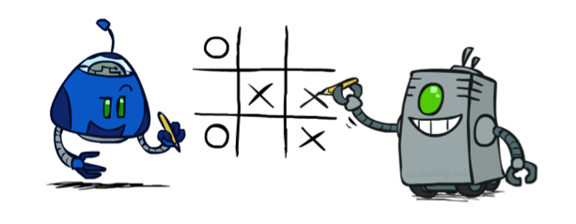
Worst-Case vs. Average Case
max
min
10
10
9
100
Idea: Uncertain outcomes controlled by chance, not an adversary!
Notes:
Would really like the 100, but a perfect adversary will not let you have it. But maybe a real-life adversary would? Or what if you actually just rolled dice? The idea is that we might want to consider some sort of average case rather than the minimax value.

Slide 4
Expectimax Search
Why wouldn’t we know what the result of an action will be?
Explicit randomness: rolling dice
Unpredictable opponents: the ghosts respond randomly
Actions can fail: when moving a robot, wheels might slip
Values should now reflect average-case (expectimax) outcomes, not worst-case (minimax) outcomes
Expectimax search: compute the average score under optimal play
Max nodes as in minimax search
Chance nodes are like min nodes but the outcome is uncertain
Calculate their expected utilities
I.e. take weighted average (expectation) of children
Later, we’ll learn how to formalize the underlying uncertain-result problems as Markov Decision Processes
max
chance
10
10
4
10
5
9
7
100
[Demo: min vs exp (L7D1,2)]
Notes:
If equally likely, 54.5 on the right, so now it looks good. Don’t know how the opponent will react, but can reason about the value of the “average” response, considering the probabilities of each move.

Slide 5

Video of Demo Minimax vs Expectimax (Min)

Slide 6
Video of Demo Minimax vs Expectimax (Exp)

Slide 7
Expectimax Pseudocode
def value(state):
if the state is a terminal state: return the state’s utility
if the next agent is MAX: return max-value(state)
if the next agent is EXP: return exp-value(state)
def max-value(state):
initialize v = -∞
for each successor of state:
v = max(v, value(successor))
return v
def exp-value(state):
initialize v = 0
for each successor of state:
p = probability(successor)
v += p * value(successor)
return v
Notes:
Pick an order for two reasons: sequential processor and pruning

Slide 8
Expectimax Pseudocode
def exp-value(state):
initialize v = 0
for each successor of state:
p = probability(successor)
v += p * value(successor)
return v
1/2
1/6
1/3
5
8
7
24
-12
v = (1/2) (8) + (1/3) (24) + (1/6) (-12) = 10

Slide 9
Expectimax Example
3
12
9
2
4
6
15
6
0

Slide 10
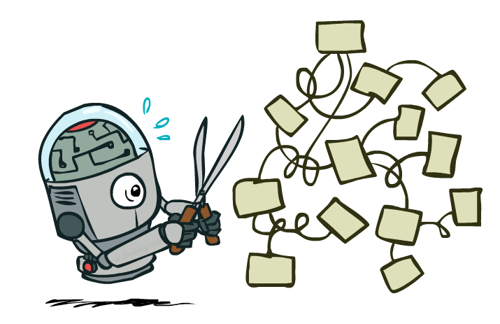
Expectimax Pruning?
3
12
9
2
Notes:
Pruning is pretty hard. We have a value of 8. Before in minimax we were able to prune when you get to the 2, because the left node has value at least 3, so the max is at least 3. But in expectimax, you can always see a huge value.

Slide 11



Depth-Limited Expectimax
Estimate of true expectimax value (which would require a lot of work to compute)
400
300
…
…
492
362
…
Notes:
Terminal values are score. We can’t look all the way to the end, so we have to cut off the search.

Slide 12
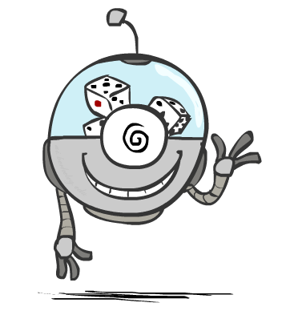
Probabilities

Slide 13
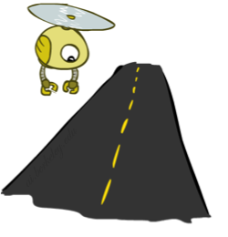
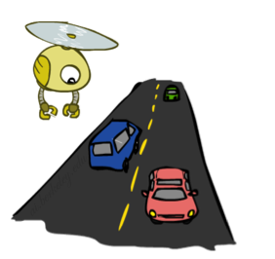
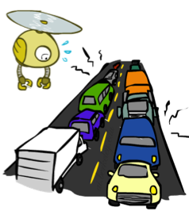
Reminder: Probabilities
A random variable represents an event whose outcome is unknown
A probability distribution is an assignment of weights to outcomes
Example: Traffic on freeway
Random variable: T = whether there’s traffic
Outcomes: T in {none, light, heavy}
Distribution: P(T=none) = 0.25, P(T=light) = 0.50, P(T=heavy) = 0.25
Some laws of probability (more later):
Probabilities are always non-negative
Probabilities over all possible outcomes sum to one
As we get more evidence, probabilities may change:
P(T=heavy) = 0.25, P(T=heavy | Hour=8am) = 0.60
We’ll talk about methods for reasoning and updating probabilities later
0.25
0.50
0.25
Notes:
Quick review of probability.

Slide 14
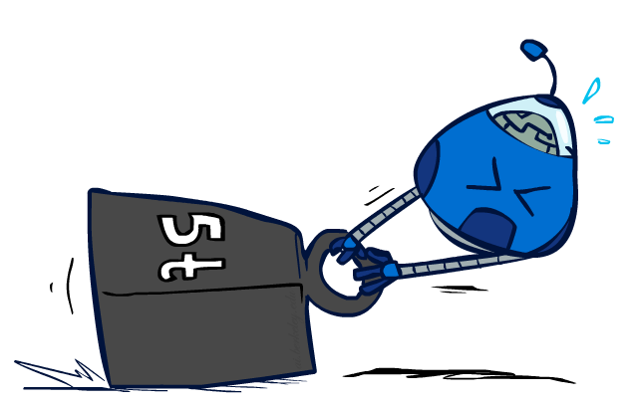
Reminder: Expectations
The expected value of a function of a random variable is the average, weighted by the probability distribution over outcomes
Example: How long to get to the airport?
Time:
20 min
30 min
60 min
+
+
35 min
x
x
x
Probability:
0.25
0.50
0.25

Slide 15

What Probabilities to Use?
In expectimax search, we have a probabilistic model of how the opponent (or environment) will behave in any state
Model could be a simple uniform distribution (roll a die)
Model could be sophisticated and require a great deal of computation
We have a chance node for any outcome out of our control: opponent or environment
The model might say that adversarial actions are likely!
For now, assume each chance node magically comes along with probabilities that specify the distribution over its outcomes
Having a probabilistic belief about another agent’s action does not mean that the agent is flipping any coins!
Notes:
Could be huge Bayesian network?

Slide 16
Quiz: Informed Probabilities
Let’s say you know that your opponent is actually running a depth 2 minimax, using the result 80% of the time, and moving randomly otherwise
Question: What tree search should you use?
Answer: Expectimax!
To figure out EACH chance node’s probabilities, you have to run a simulation of your opponent
This kind of thing gets very slow very quickly
Even worse if you have to simulate your opponent simulating you…
… except for minimax, which has the nice property that it all collapses into one game tree
0.1 0.9
Notes:
If you model each other as MAX and MIN, nice collapse. Otherwise, you have to do a lot of searching inside searching.

Slide 17

Modeling Assumptions

Slide 18
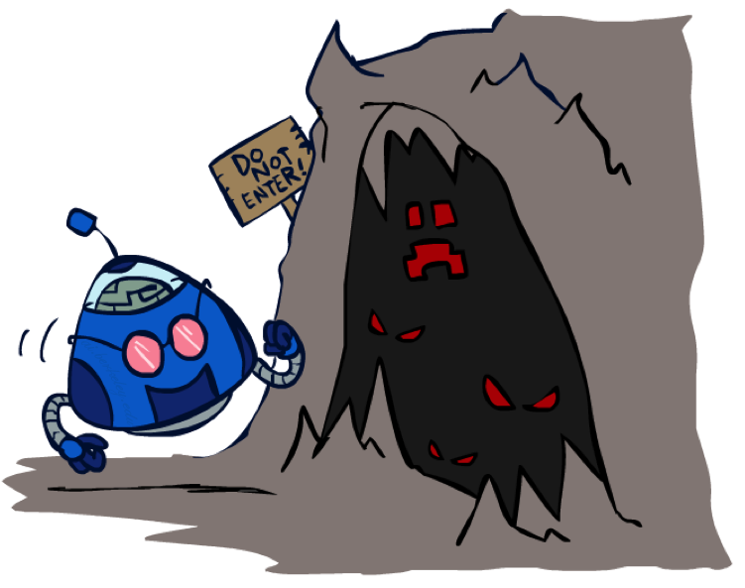
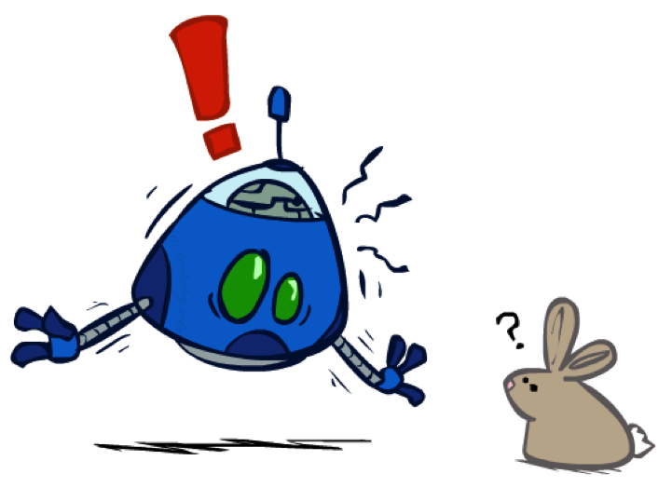
The Dangers of Optimism and Pessimism
Dangerous Optimism
Assuming chance when the world is adversarial
Dangerous Pessimism
Assuming the worst case when it’s not likely

Slide 19
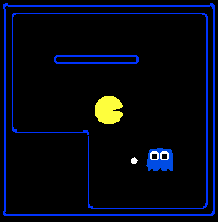
Assumptions vs. Reality
 | Adversarial Ghost | Random Ghost
Minimax Pacman | Won 5/5 Avg. Score: 483 | Won 5/5 Avg. Score: 493
Expectimax Pacman | Won 1/5 Avg. Score: -303 | Won 5/5 Avg. Score: 503
Results from playing 5 games
Pacman used depth 4 search with an eval function that avoids trouble Ghost used depth 2 search with an eval function that seeks Pacman
[Demos: world assumptions (L7D3,4,5,6)]
Notes:
python pacman.py -g SmartGhost -l trapped2 -p ExpectimaxAgent -a depth=4,evalFn=better

Slide 20
Video of Demo World Assumptions Random Ghost – Expectimax Pacman

Slide 21
Video of Demo World Assumptions Adversarial Ghost – Minimax Pacman

Slide 22
Video of Demo World Assumptions Adversarial Ghost – Expectimax Pacman

Slide 23
Video of Demo World Assumptions Random Ghost – Minimax Pacman

Slide 24
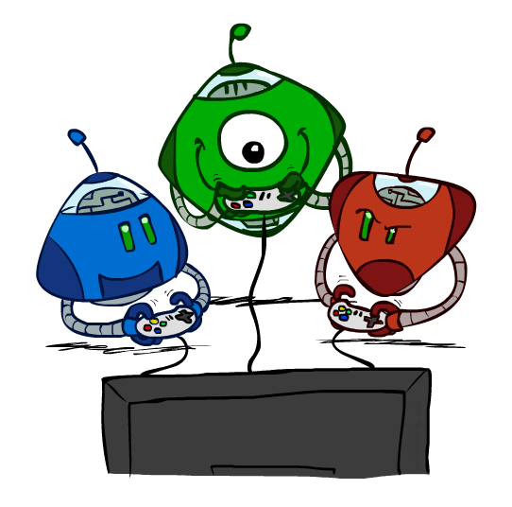
Other Game Types

Slide 25



Mixed Layer Types
E.g. Backgammon
Expectiminimax
Environment is an extra “random agent” player that moves after each min/max agent
Each node computes the appropriate combination of its children
Notes:
Can use same dispatch based code for this! Just know what type of player goes next and either take a min, max, or weighted average of children.

Slide 26
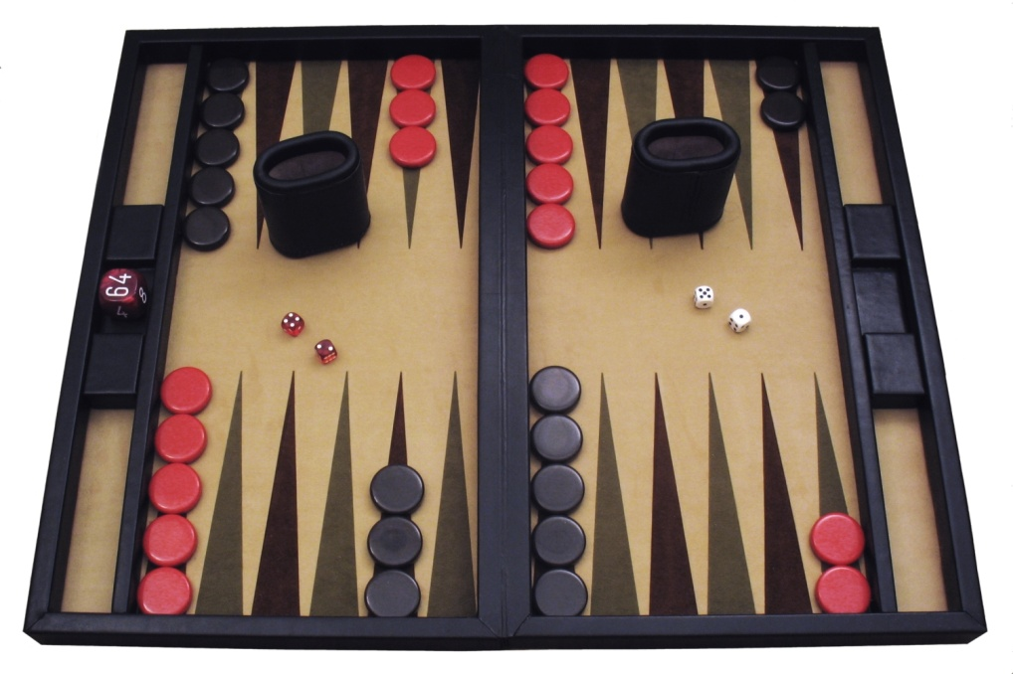
Example: Backgammon
Dice rolls increase b: 21 possible rolls with 2 dice
Backgammon ≈ 20 legal moves
Depth 2 = 20 x (21 x 20)³ = 1.2 x 10⁹
As depth increases, probability of reaching a given search node shrinks
So usefulness of search is diminished
So limiting depth is less damaging
But pruning is trickier…
Historic AI: TDGammon uses depth-2 search + very good evaluation function + reinforcement learning: world-champion level play
1st AI world champion in any game!
Image: Wikipedia

Slide 27
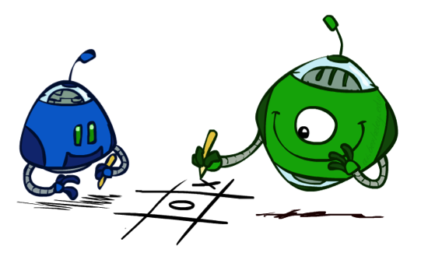
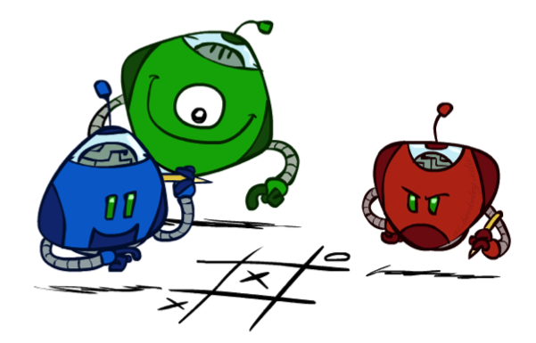
Multi-Agent Utilities
What if the game is not zero-sum, or has multiple players?
Generalization of minimax:
Terminals have utility tuples
Node values are also utility tuples
Each player maximizes its own component
Can give rise to cooperation and
competition dynamically…
1,6,6
7,1,2
6,1,2
7,2,1
5,1,7
1,5,2
7,7,1
5,2,5
Notes:
Now we have tuples of all utilities, and everyone maxes their own utilities. This is how people play Risk. Complex behavior comes out of simple code!

Slide 28
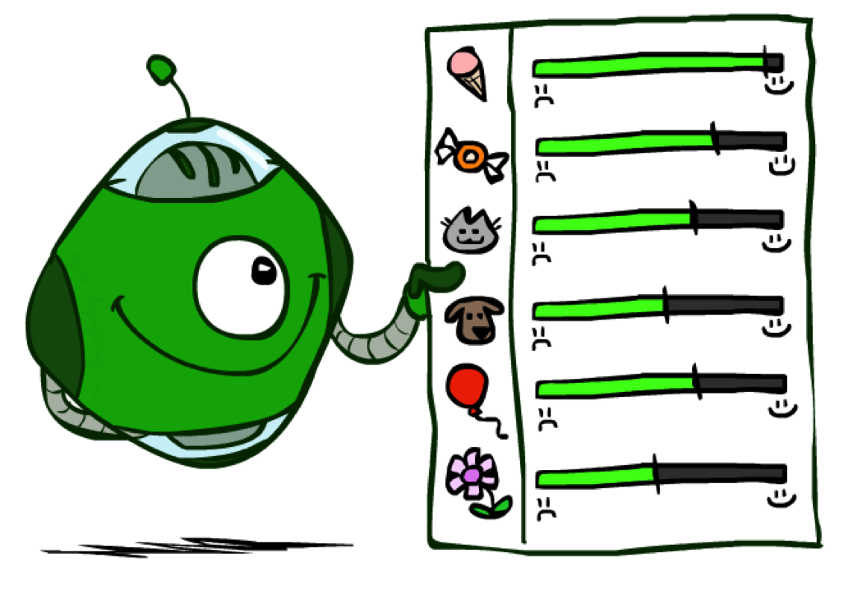
Utilities
Notes:
We keep talking about utilitie…what are they?

Slide 29

Maximum Expected Utility
Why should we average utilities? Why not minimax?
Principle of maximum expected utility:
A rational agent should chose the action that maximizes its expected utility, given its knowledge
Questions:
Where do utilities come from?
How do we know such utilities even exist?
How do we know that averaging even makes sense?
What if our behavior (preferences) can’t be described by utilities?
Notes:
Worst case reasoning keeps you at home forever because you might be struck by lightning! If we want to be able to let bad things happen (but rarely), we need to be able to take averages. Expected utilities are very useful, and keeping track of probabilities as we learn new knowledge, and this will be important later on.

Slide 30
What Utilities to Use?
0
40
20
30
x²
0
1600
400
900
For worst-case minimax reasoning, terminal function scale doesn’t matter
We just want better states to have higher evaluations (get the ordering right)
We call this insensitivity to monotonic transformations
For average-case expectimax reasoning, we need magnitudes to be meaningful

Slide 31

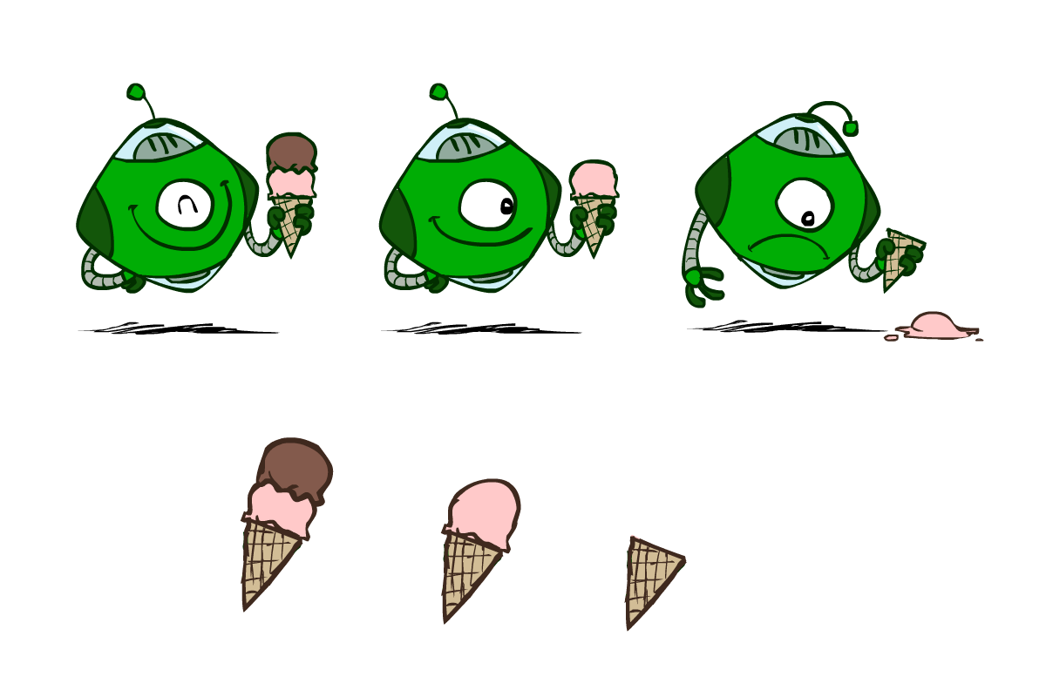
Utilities
Utilities are functions from outcomes (states of the world) to real numbers that describe an agent’s preferences
Where do utilities come from?
In a game, may be simple (+1/-1)
Utilities summarize the agent’s goals
Theorem: any “rational” preferences can be summarized as a utility function
We hard-wire utilities and let behaviors emerge
Why don’t we let agents pick utilities?
Why don’t we prescribe behaviors?

Slide 32
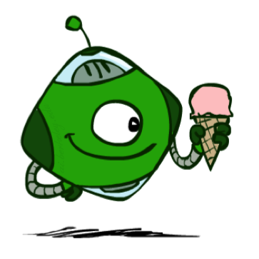
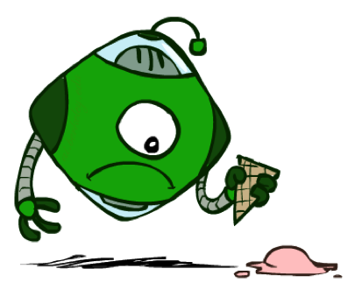
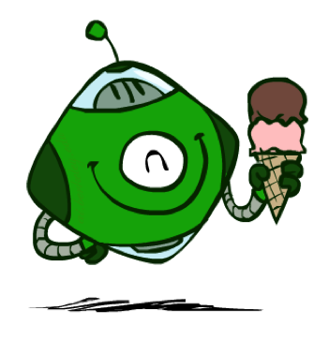
Utilities: Uncertain Outcomes
Getting ice cream
Get Single
Get Double
Oops
Whew!
Notes:
Does it prefer 1 safe or some mixture of 0 and 2 scoops? The utilities specify which of these worlds is better, and there is no right answer, but we do need to be able to distinguish them an utilities are a good way to do so.

Slide 33
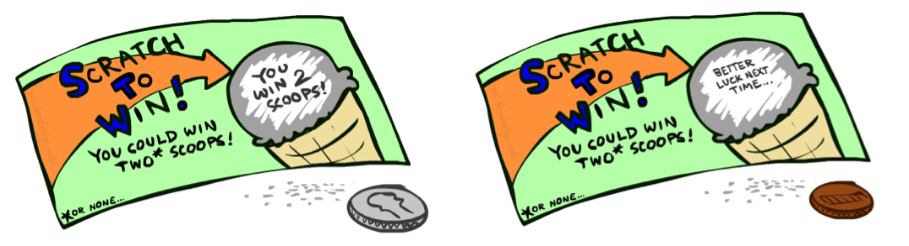
Preferences
A Prize
A Lottery
An agent must have preferences among:
Prizes: A, B, etc.
Lotteries: situations with uncertain prizes
Notation:
Preference:
Indifference:
A
p 1-p
A B
Notes:
Expecimax is recursive lotteries. Important to take the fun out of gambling. It’s just randomness, no value to the experience. No stake is offered.

Slide 34
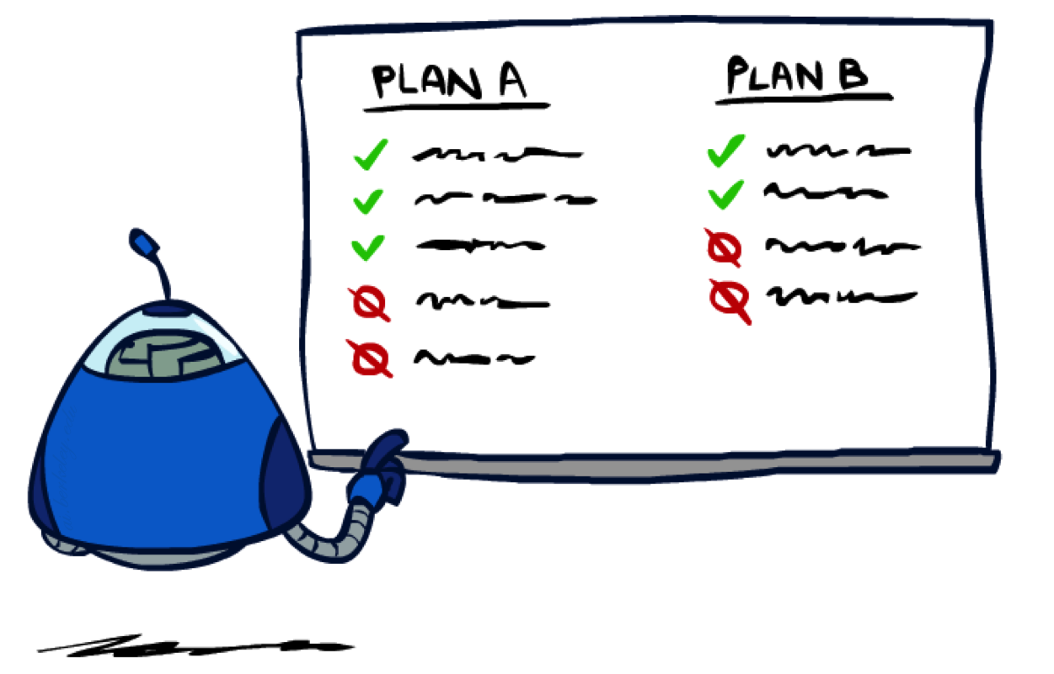
Rationality

Slide 35
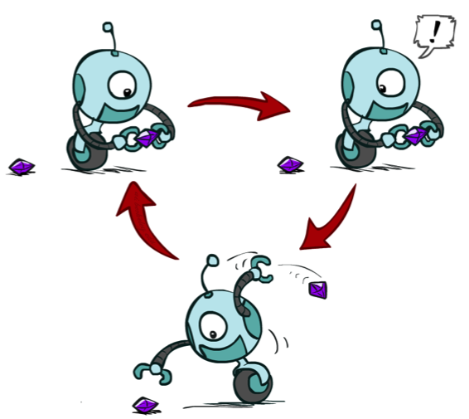
Rational Preferences
We want some constraints on preferences before we call them rational, such as:
For example: an agent with intransitive preferences can
be induced to give away all of its money
If B > C, then an agent with C would pay (say) 1 cent to get B
If A > B, then an agent with B would pay (say) 1 cent to get A
If C > A, then an agent with A would pay (say) 1 cent to get C
Axiom of Transitivity:
Notes:
Lots of valid preferences, but some simply make no sense, and we will place some restrictions on them.

Slide 36

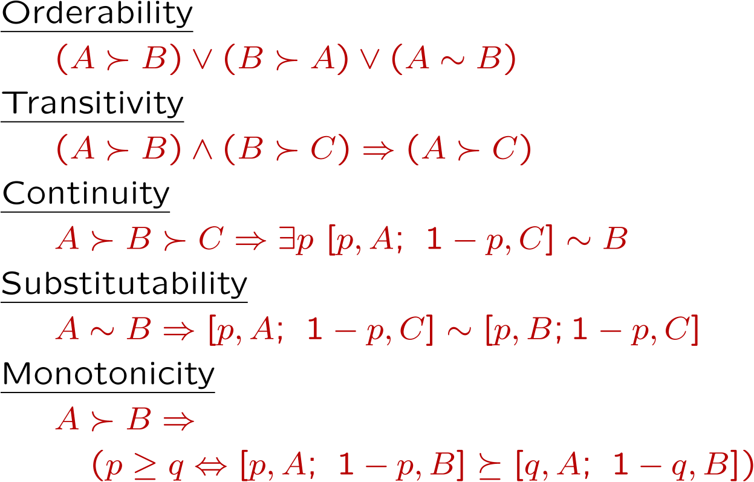
Rational Preferences
The Axioms of Rationality
Theorem: Rational preferences imply behavior describable as maximization of expected utility
Notes:
Orderability: either A or B is better, or you’re indifferent. Continuity: if A < B < C, there is some lottery between A and C that is indifferent to B. Substitutability: if A is indifferent to B, you are also indifferent to two otherwise identical lotteries containing them. Monotonicity: if you prefer A to B, you prefer lotteries with more A than B.

Slide 37
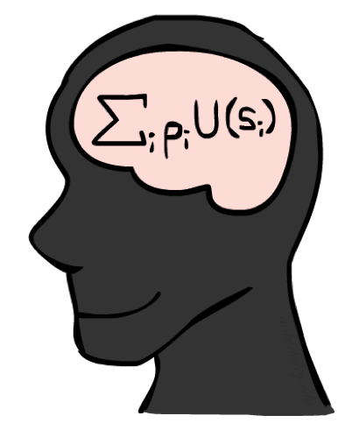
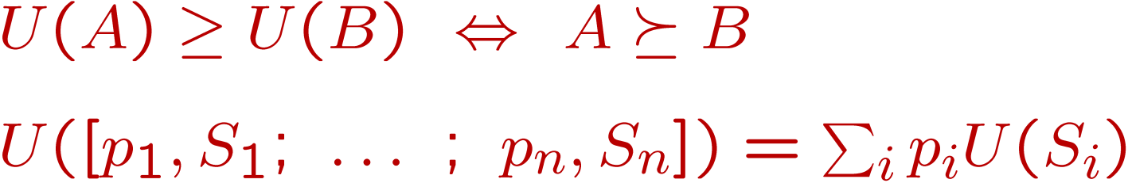
MEU Principle
Theorem [Ramsey, 1931; von Neumann & Morgenstern, 1944]
Given any preferences satisfying these constraints, there exists a real-valued
function U such that:
I.e. values assigned by U preserve preferences of both prizes and lotteries!
Maximum expected utility (MEU) principle:
Choose the action that maximizes expected utility
Note: an agent can be entirely rational (consistent with MEU) without ever representing or manipulating utilities and probabilities
E.g., a lookup table for perfect tic-tac-toe, a reflex vacuum cleaner

Slide 38
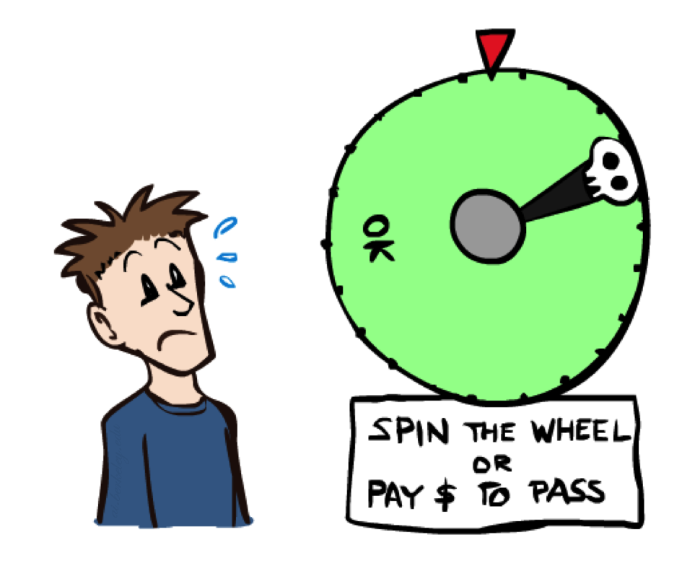
Human Utilities

Slide 39

Utility Scales
Normalized utilities: u₊ = 1.0, u₋ = 0.0
Micromorts: one-millionth chance of death, useful for paying to reduce product risks, etc.
QALYs: quality-adjusted life years, useful for medical decisions involving substantial risk
Note: behavior is invariant under positive linear transformation
With deterministic prizes only (no lottery choices), only ordinal utility can be determined, i.e., total order on prizes
Notes:
Micromorts for recall. Need to use lotteries to find entire utility function.

Slide 40


Human Utilities
Utilities map states to real numbers. Which numbers?
Standard approach to assessment (elicitation) of human utilities:
Compare a prize A to a standard lottery L_{p} between
“best possible prize” u₊ with probability p
“worst possible catastrophe” u₋ with probability 1-p
Adjust lottery probability p until indifference: A ~ L_{p}
Resulting p is a utility in [0,1]
Pay $30
0.999999 0.000001
No change
Instant death
Notes:
In this case, -$30 = Micromort. Probably crippling lifelong debt = more micromorts.

Slide 41
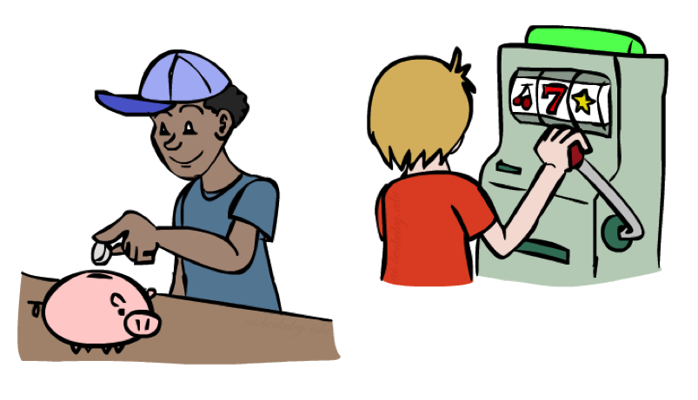
Money
Money does not behave as a utility function, but we can talk about the utility of having money (or being in debt)
Given a lottery L = [p, $X; (1-p), $Y]
The expected monetary value EMV(L) is p*X + (1-p)*Y
U(L) = p*U($X) + (1-p)*U($Y)
Typically, U(L) < U( EMV(L) )
In this sense, people are risk-averse
When deep in debt, people are risk-prone
Notes:
Draw Jensen’s for utility curve

Slide 42
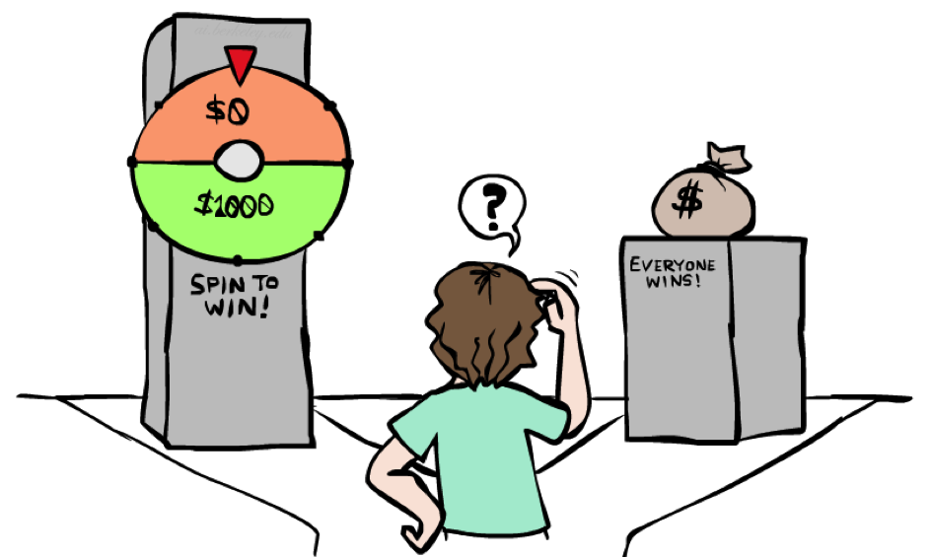
Example: Insurance
Consider the lottery [0.5, $1000; 0.5, $0]
What is its expected monetary value? ($500)
What is its certainty equivalent?
Monetary value acceptable in lieu of lottery
$400 for most people
Difference of $100 is the insurance premium
There’s an insurance industry because people will pay to reduce their risk
If everyone were risk-neutral, no insurance needed!
It’s win-win: you’d rather have the $400 and the insurance company would rather have the lottery (their utility curve is flat and they have many lotteries)

Slide 43

Example: Human Rationality?
Famous example of Allais (1953)
A: [0.8, $4k; 0.2, $0]
B: [1.0, $3k; 0.0, $0]
C: [0.2, $4k; 0.8, $0]
D: [0.25, $3k; 0.75, $0]
Most people prefer B > A, C > D
But if U($0) = 0, then
B > A ⇒ U($3k) > 0.8 U($4k)
C > D ⇒ 0.8 U($4k) > U($3k)

Slide 44
Next Time: MDPs!

Slide 45
What are Probabilities?
Objectivist / frequentist answer:
Averages over repeated experiments
E.g. empirically estimating P(rain) from historical observation
Assertion about how future experiments will go (in the limit)
New evidence changes the reference class
Makes one think of inherently random events, like rolling dice
Subjectivist / Bayesian answer:
Degrees of belief about unobserved variables
E.g. an agent’s belief that it’s raining, given the temperature
E.g. pacman’s belief that the ghost will turn left, given the state
Often learn probabilities from past experiences (more later)
New evidence updates beliefs (more later)

Slide 46
Uncertainty Everywhere
Not just for games of chance!
I’m sick: will I sneeze this minute?
Email contains “FREE!”: is it spam?
Tooth hurts: have cavity?
60 min enough to get to the airport?
Robot rotated wheel three times, how far did it advance?
Safe to cross street? (Look both ways!)
Sources of uncertainty in random variables:
Inherently random process (dice, etc)
Insufficient or weak evidence
Ignorance of underlying processes
Unmodeled variables
The world’s just noisy – it doesn’t behave according to plan!
Compare to fuzzy logic, which has degrees of truth, rather than just degrees of belief

